Slide 1
Minicycle
20210723

Slide 2
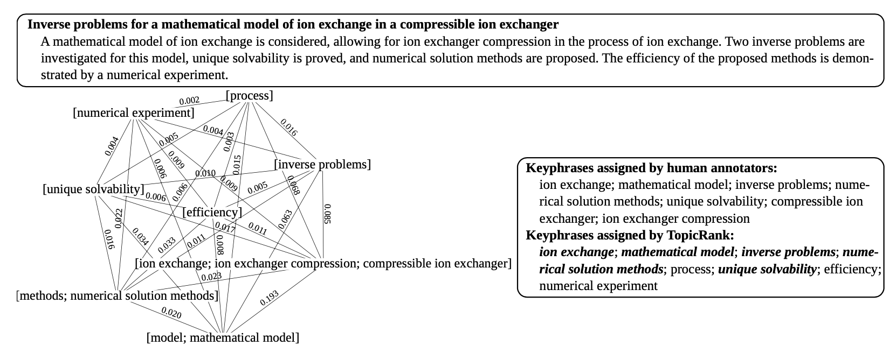
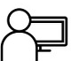
Goal
키워드 입력
뉴스 크롤링
사용자
텍스트 분석
결과 시각화

Slide 3
Architecture
Worker
BigProcesser
UnitProcesser
Graph
Scraper
UnitProcesser
Topic
. . .
Loader
UnitProcesser

Slide 4
What changed?
SimpleWorker
TinyProcesser
dataset
Graph
Scraper
targets
본문
News
Topic
링크, 제목, 본문, 날짜, 검색어, 언어, 상태
Loader

Slide 5
Workflow
Data Load
Preprocessing
Candidate Extraction
Candidate Filtering
Visualization
Association analysis
Count-based Ranking

Slide 6
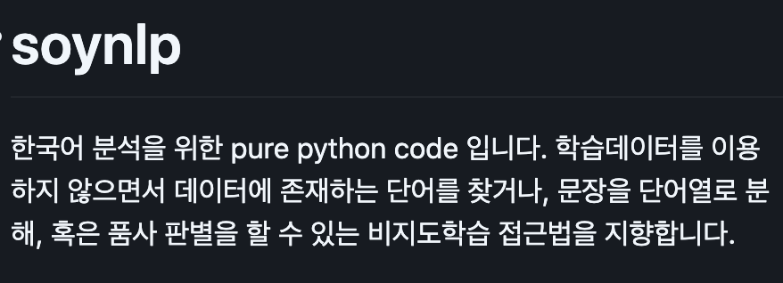

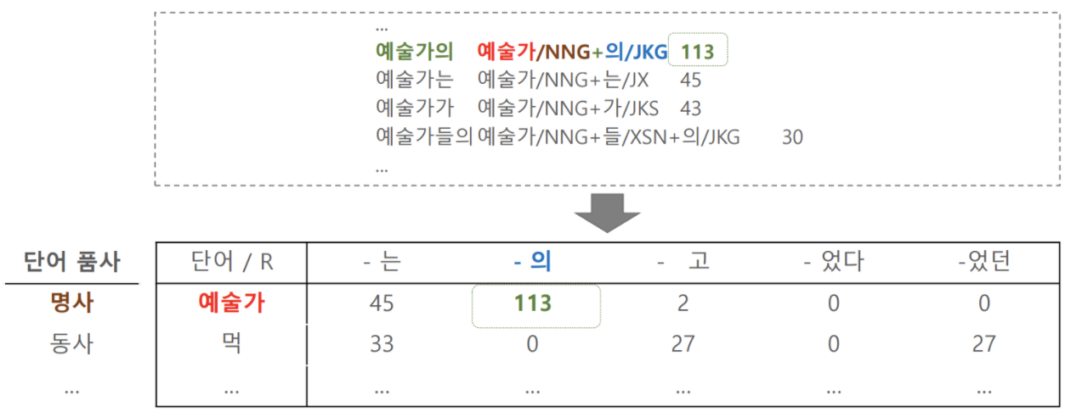
Candidate Selection
def select_candidates(self):
noun_extractor = LRNounExtractor_v2(verbose=True)
nouns = noun_extractor.train_extract(self.dataset)
self.candidates = nouns
L-R Pattern
조사: 명사 가능성 ⬆️
어미: 명사 가능성 ⬇️
L + [R]
https://github.com/lovit/soynlp
의미적 기능
명사 / 동사 / 형용사 / 부사
문법적 기능
조사 / 어미
재미있게 = 재미 + 있게 O
재미있는 = 재미 + 있는 O
서양 철학은 = 서양 철학 + 은 O
김정은 = 김정 + 은 ?

Slide 7
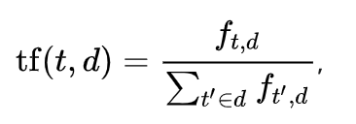
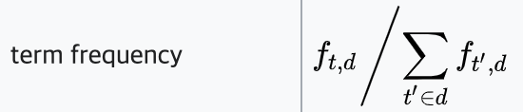
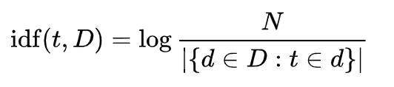
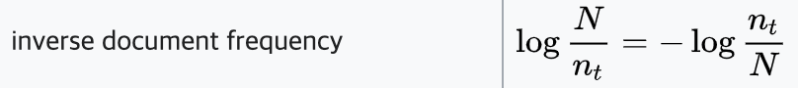
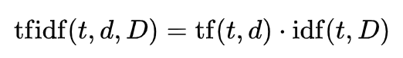
Count-based Ranking
def simpleTfIdf(self):
c = list(self.candidates.keys())
f_dataset = list()
for i, _ in enumerate(self.dataset):
f_dataset.append(helper.filter_text(self.dataset[i], c))
total_words = sum([len(text.split()) for text in f_dataset])
total_num_text = len(f_dataset)
for each_c in c:
for i, _ in enumerate(self.dataset):
cnt = len(self.dataset[i].split(each_c)) - 1
num_words = len(self.datset[i].split()) – 1
self.tf_score[each_c] = self.tf_score.get(each_c, 0) + cnt / num_words
self.idf_score[each_c] = sum([ 1 if each_c in dataset else 0 for dataset in f_dataset])
self.tf_score.update([[candidate, tf/total_words] for candidate, tf in self.tf_score.items()])
self.idf_score.update([[candidate, math.log(total_num_text / idf)] for candidate, idf in self.idf_score.items()])
self.tf_idf_score = {key: self.tf_score[key] * self.idf_score[key] for key in self.tf_score.keys()}

Slide 8
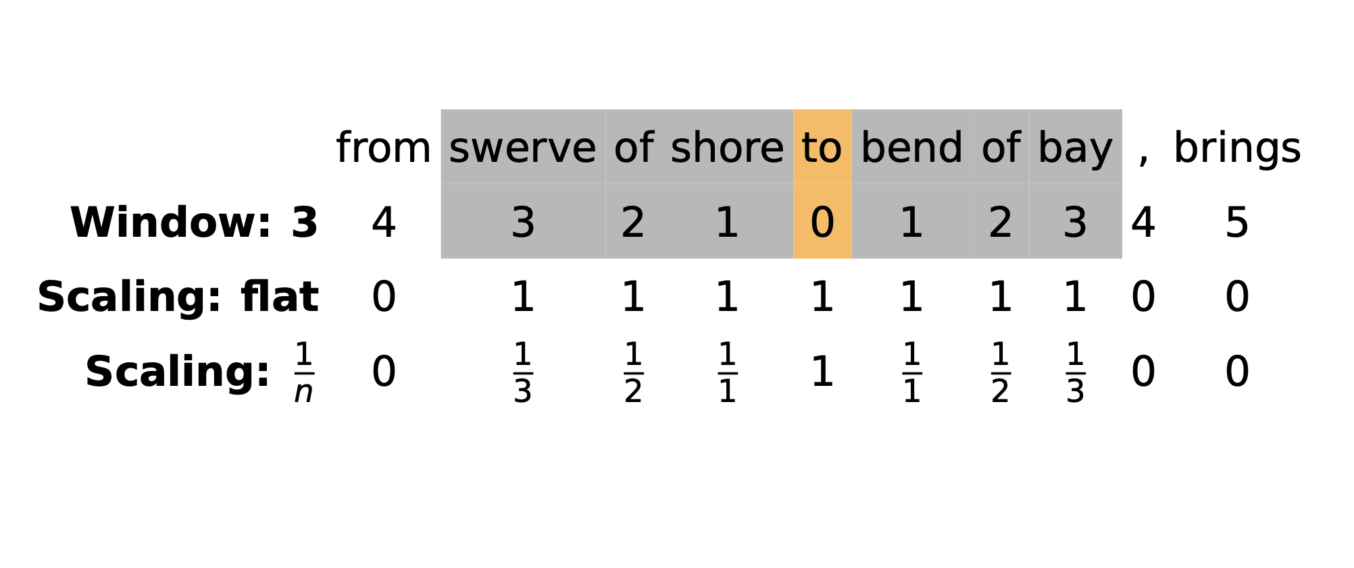
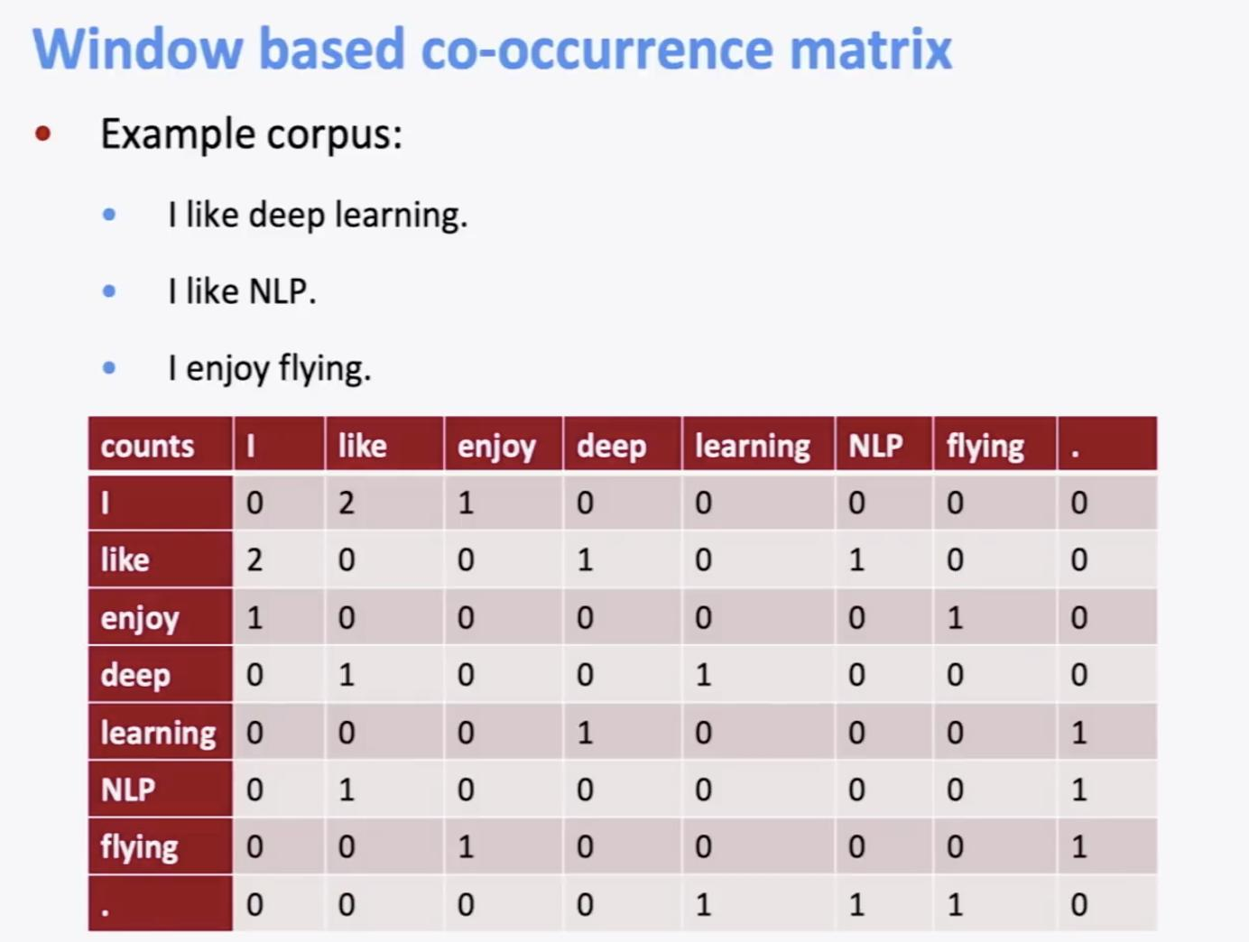
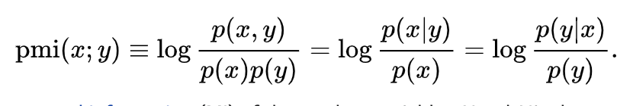
Association Analysis
def pmi(self):
corpus = list()
c = list(self.candidates.keys())
for doc in self.dataset:
sents = kss.split_sentences(doc)
for i, _ in enumerate(sents):
corpus.append(helper.filter_text(sents[i], c))
x, idx2vocab = sent_to_word_contexts_matrix(
corpus,
windows=5,
min_tf=10,
dynamic_weight=False,
verbose=True
)
pmi_dok, px, py = pmi(
x,
min_pmi=0,
alpha=0.0001
)
return idx2vocab, pmi_dok

Slide 9

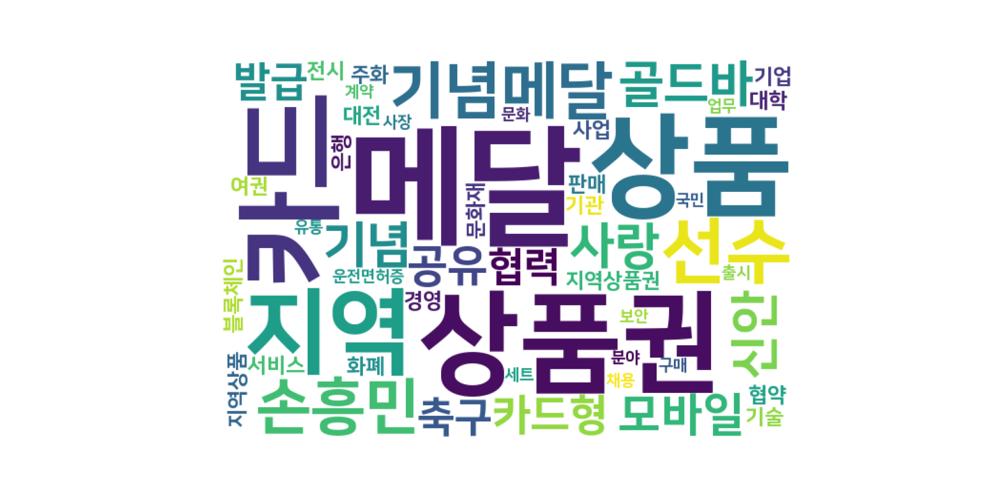
Visualization
2016년
2021년

Slide 10
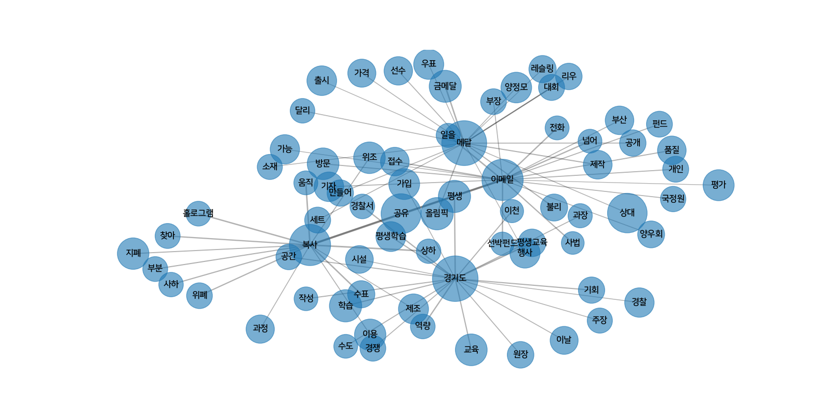
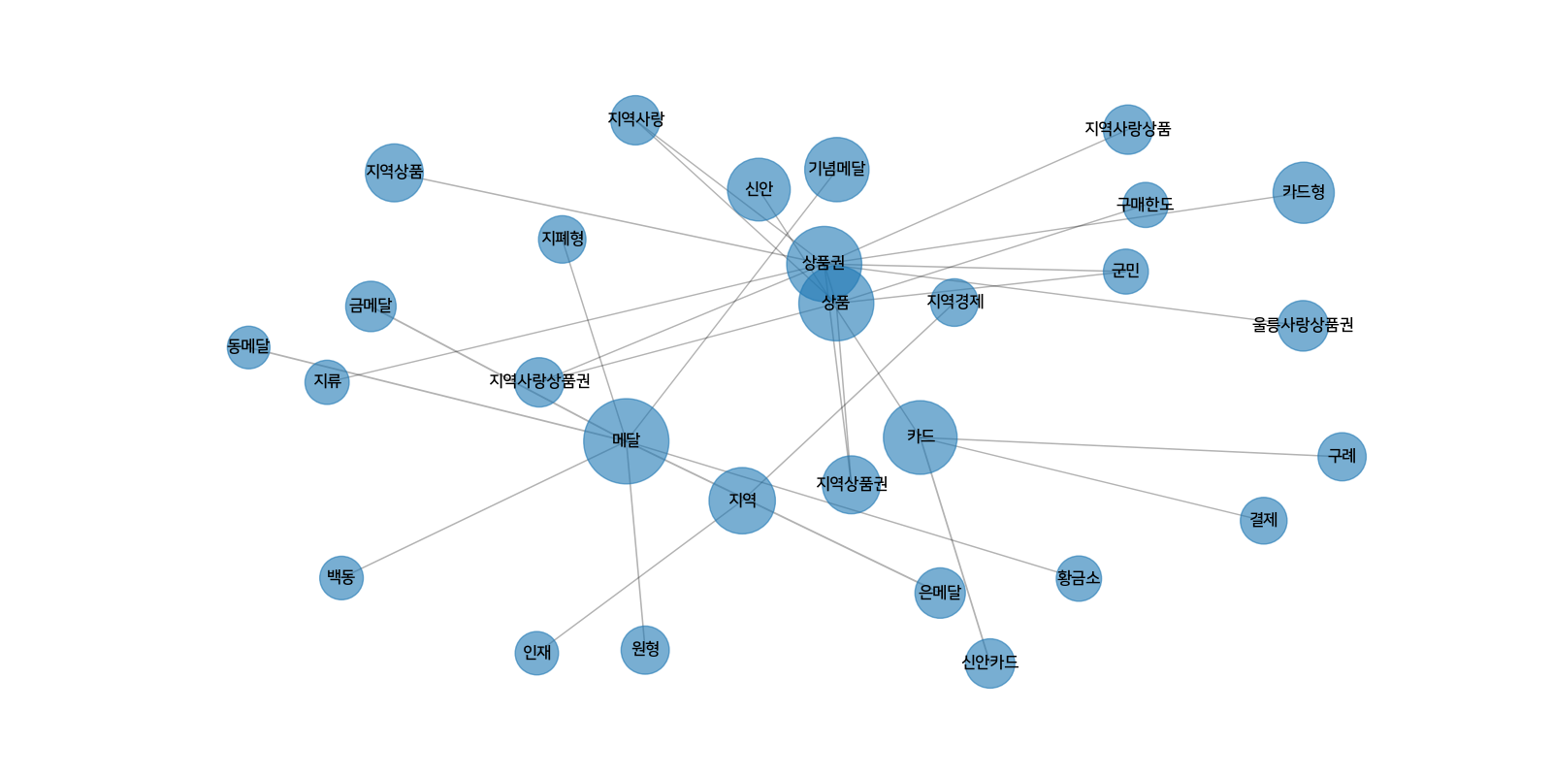
Visualization
2016년
2021년

Slide 11
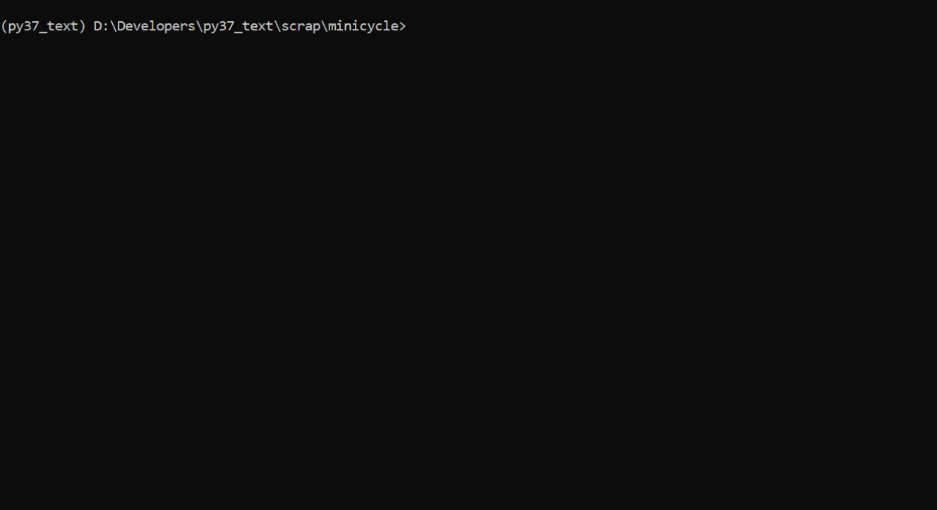
Demo

